Slide 1
HR Data & employee performance
Dina Adel 20106871
Ahmed AlaaEldin 20107896
Abdelrahman Sherif 20107171

Slide 2
ABOUT the scenario
We are building a data warehouse for AdventureWorks to analyze human resources data and employee performance. The company wants to gain insights into employee demographics, track employee training, and analyze performance reviews.

Slide 3
Business requirements
Employee demographic analysis
Training completion analysis
Manager performance
Track and analyze employee training completion.
Evaluate the performance of the manager based on the performance of the employees, identify the pattern over the years throughout the years
Analyze the demographic of the employee workforce, and identify trends in employee hiring based on gender, job title, and marital status.

Slide 4
Cont. Business requirements
Employee tenure overtime
Performance Trends Over Time
Enhanced customer insights
Understanding buying patterns, preferences, and online behavior to personalize marketing strategies.
Track employee performance trends over time.
Identify any patterns or trends in performance ratings across different years.
Analyze employee tenure and turnover. Identify any pattern or trends in performance ratings throughout the years.

Slide 5
Fact tables and dimensions

Slide 6
Dimensions
Employee
Manager
Purpose: Provides descriptive information about employees, including names, addresses, contact details, job titles, department affiliations, and hire dates.
Purpose: Similar to DimEmployee, but specific to managers. It can include additional attributes related to team management, performance reviews, or leadership experience.

Slide 7
Cont. Dimensions
Department
Job Role
Purpose: Defines the organizational structure of the company, including department names, reporting relationships, and functional areas.
Purpose: Categorizes different job roles within the company, including titles, descriptions, responsibilities, and salary ranges.

Slide 8
Cont. Dimensions
Date
Customer
Purpose: Provides calendar information for temporal analysis, including years, months, quarters, weeks, days, and even hours.
Purpose: offers information about the customers like name ,email, phone and address . It also provides info about their orders and their account and the sales person they with whom they did business.

Slide 9
Cont. Dimensions
ProductSales
Sales
Purpose: gives info about the sales of the products like name , standard cost , list cost , category and subcategory also order id and order quantity
Purpose: Captures information about the employees sales , quotas , commission , last year sales and current sales

Slide 10
Cont. Dimensions
Training
Purpose: provide info about training , training location , category and department responsible and the time duration for that training

Slide 11
Fact tables
Employee Performance
Manager Sales
Stores employee performance metrics, including sales quotas, commission rates, sales figures, and historical sales data.
Dimensions: DimDate, DimSales, DimEmployee
Stores sales performance metrics specifically for managers, including quotas, sales figures, and employee data.
Dimensions: DimManager, DimDate,DimSales
Internet sales
Employee Training
Stores detailed internet sales data, including customer information, products purchased, order details, and sales figures.
Dimensions: DimCustomer, DimProduct
Tracks employee training activities, including training details, duration, and employee information.
Dimensions: DimEmployee, DimManager, DimDepartment, DimTraining
Manpower
Connects departments, managers, and employees, to be able to track down the number of managers in each departments
Dimensions: DimEmployee, DimDepartment, DimJobRole, DimManager

Slide 12
Cubes & analysis structure

Slide 13
Applying cubes
Applying OLAP cubes to your project unlocks multidimensional analysis, allowing you to slice and dice data across dimensions like departments, employees, and time. Cubes offer fast performance, pre-aggregated data, trend analysis, scenario simulations, and collaborative visualization, ultimately empowering you to optimize your project's performance and make informed decisions.

Slide 14
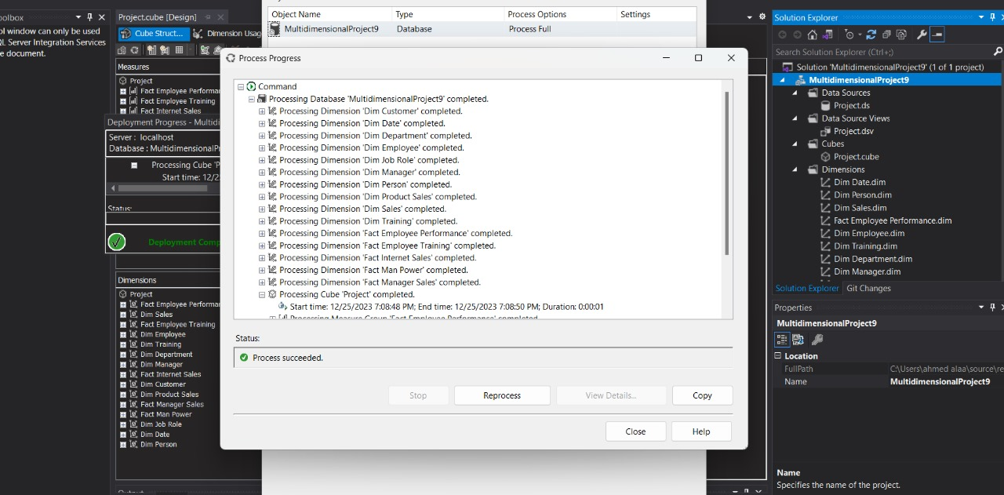
Processing the solution
Here in this figure, we can visualize the DB solution being processed on visual studio to visualize the cube

Slide 15
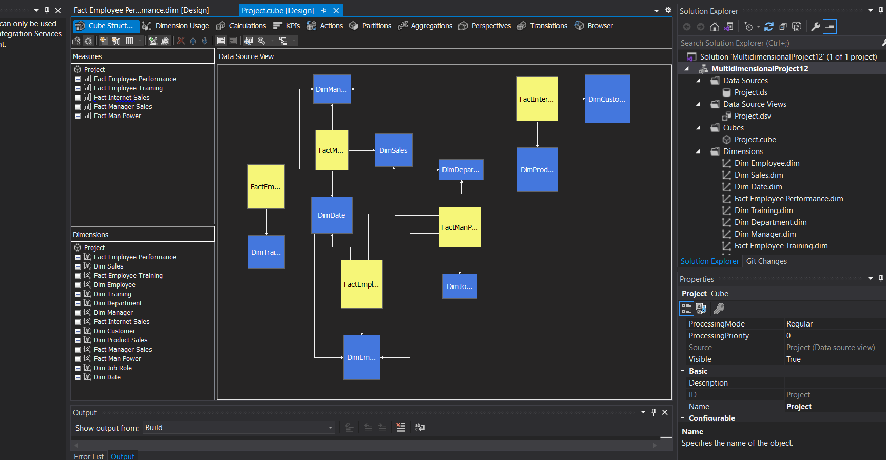
The final cube
In this figure, we can see a zoomed-out version of the cube, representing the connection between the fact tables and the dimensions.

Slide 16
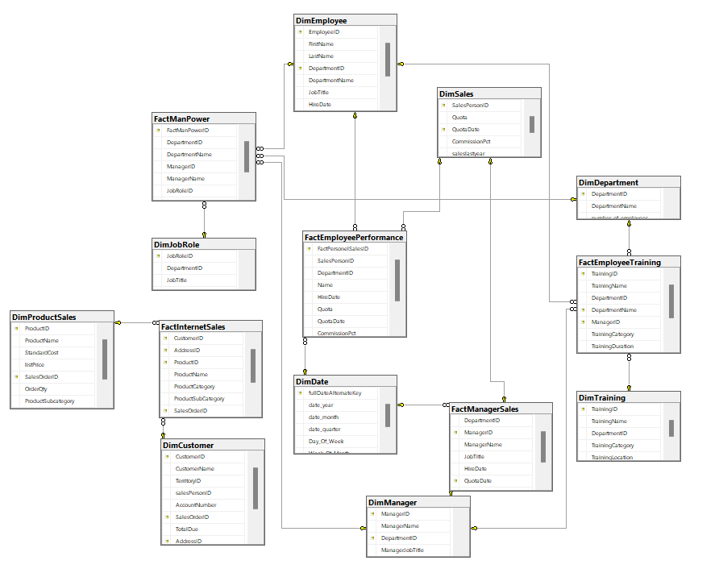
The final structure
Here is a clearer version of the structure, including visible fact tables and dimensions.

Slide 17
Power bi application

Slide 18
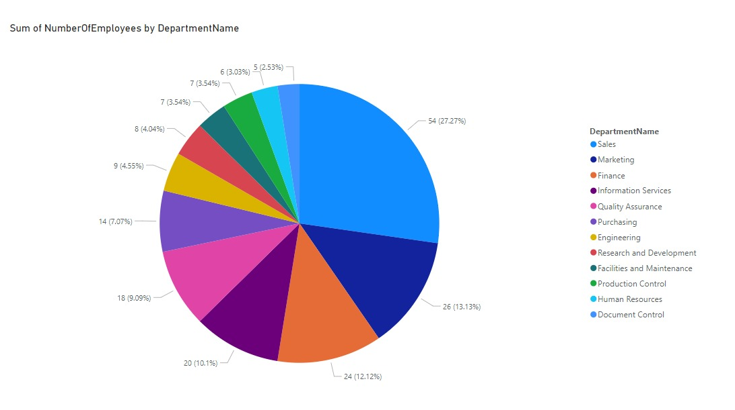
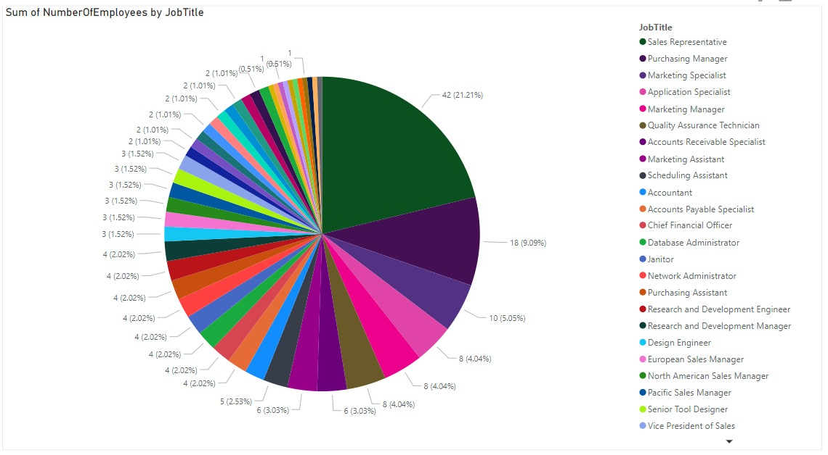
Manpower
Visualizing data related to workforce and staffing level
Number of employees in each department
Number of employees for each job title

Slide 19
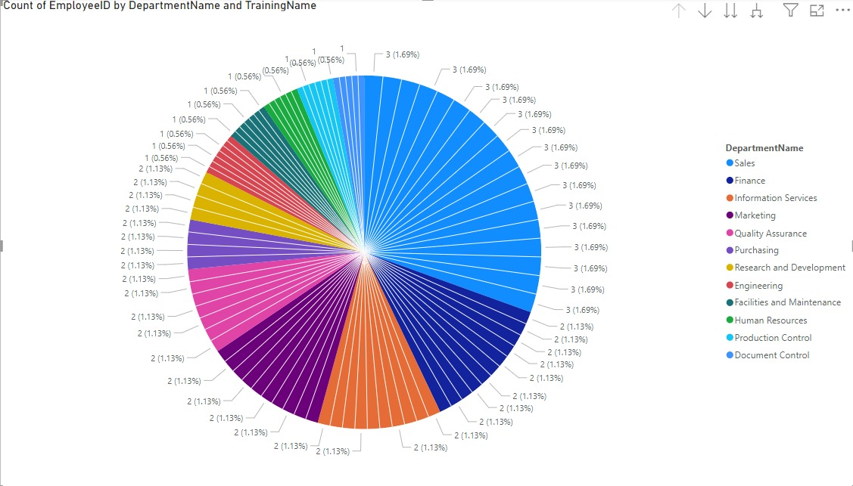
Employee training
Tracks employee training activities, including training details, duration, and employee information.
In this analysis: sorting the employees by ID to departments and training names.

Slide 20
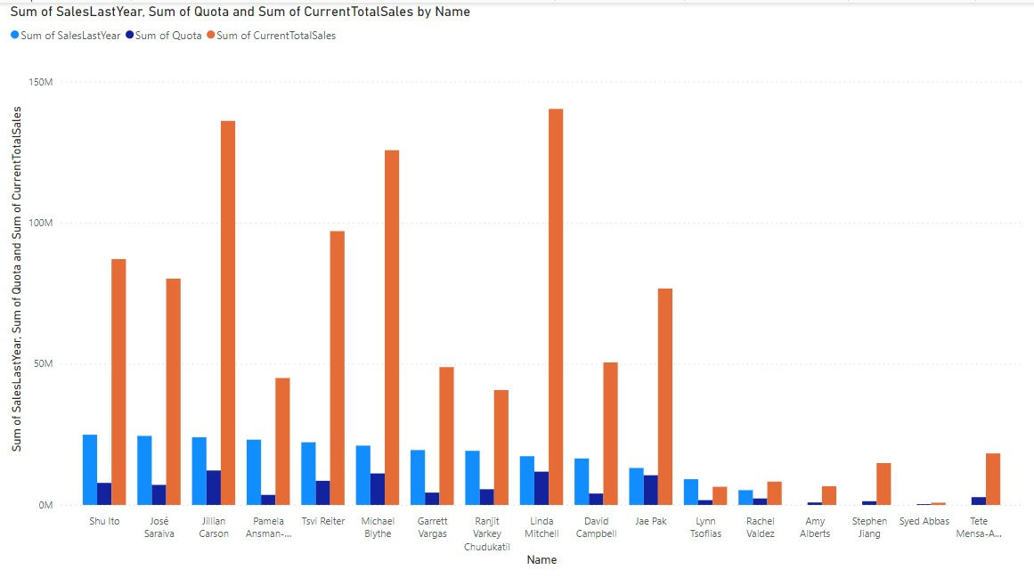
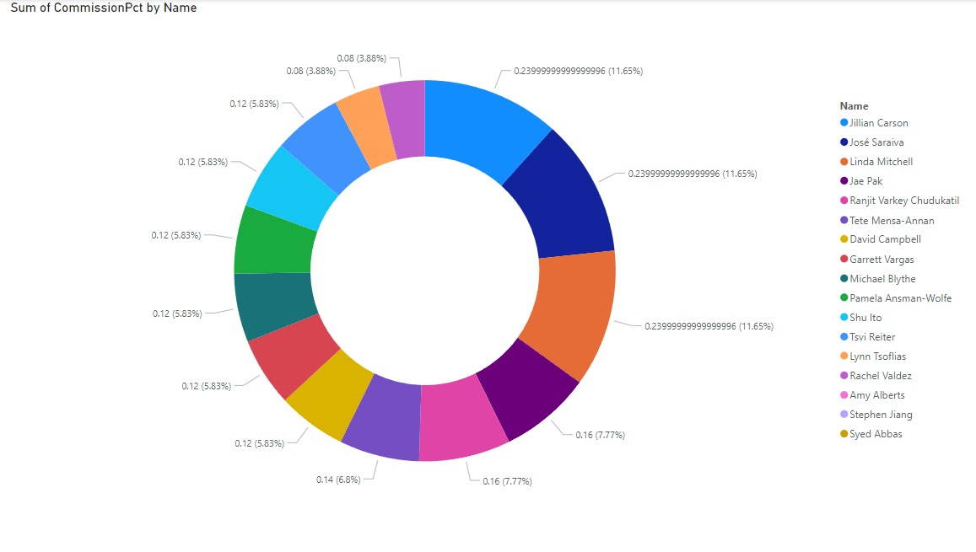
Employee performance
Stores employee performance metrics.
Comparing between sales of last year, sales of the current year, and the sum of quota for each.
Sum of commissions for each employee sum.

Slide 21
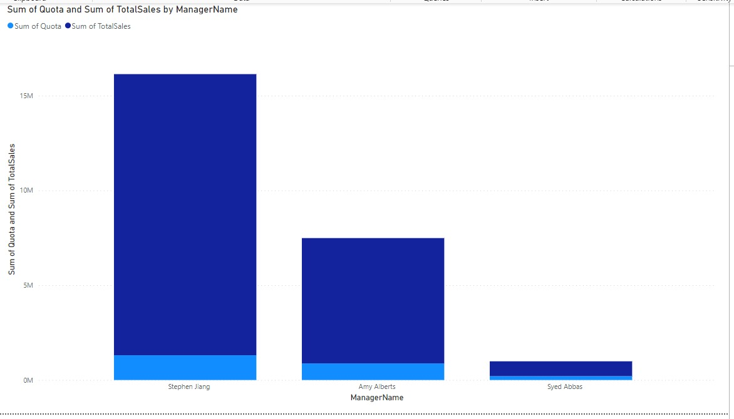
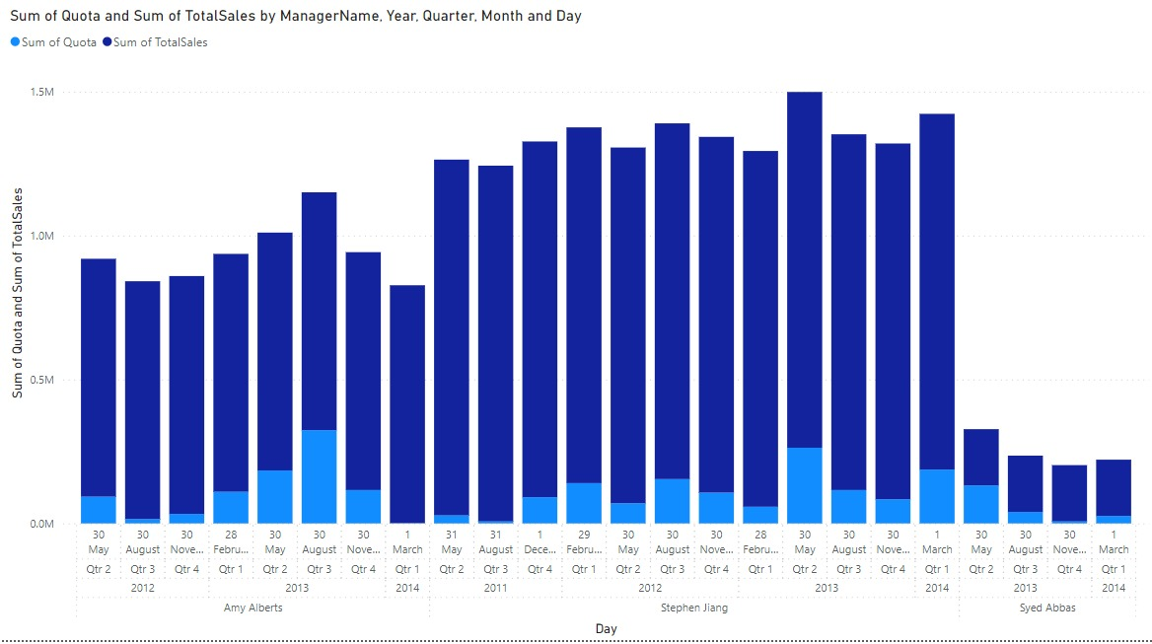
Manager sales
Stores sales performance metrics specifically for managers.
Displays the sum of total sales and Quota for each manager
Visualizing the same aspect but with attention to the date.

Slide 22
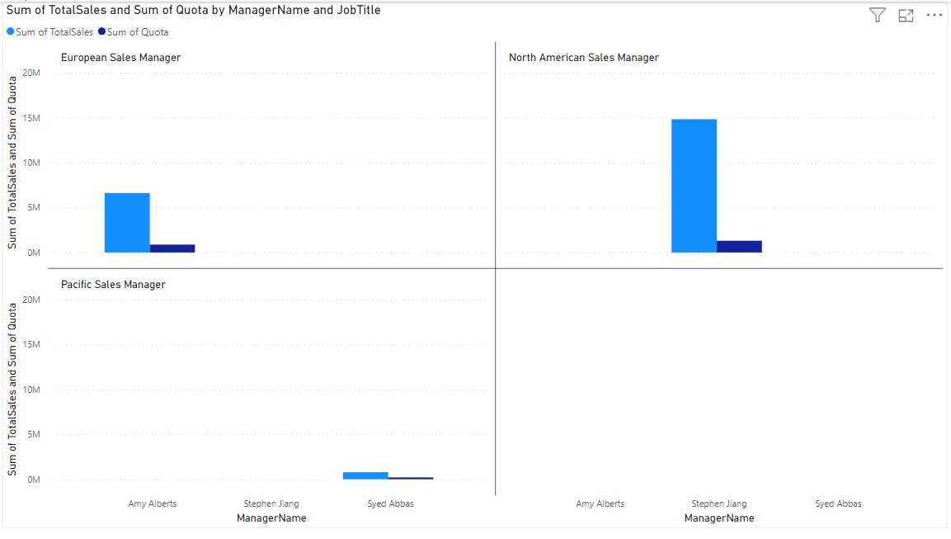
Cont. manager sales
In this analysis: the sum of total sales and quota according to the manager's name and the job title

Slide 23
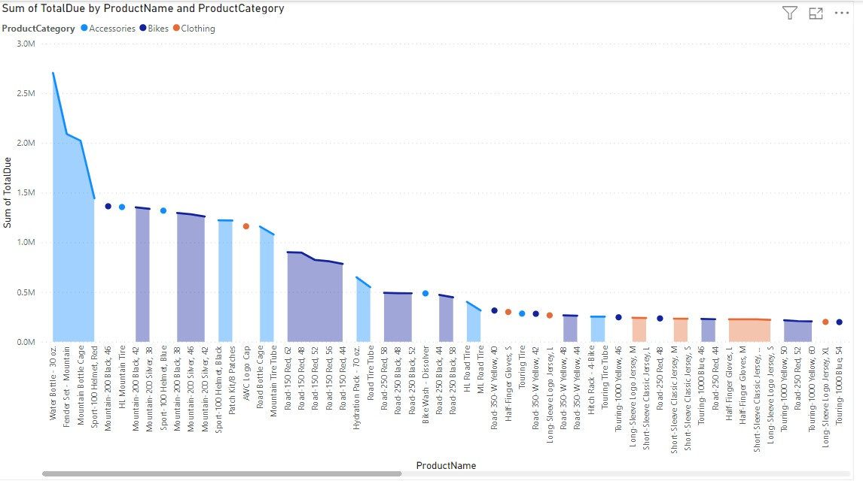
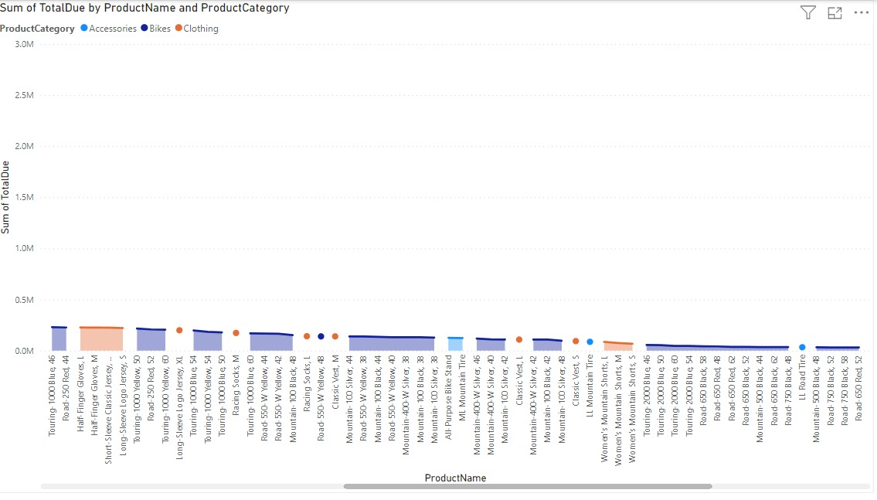
Internet sales
Stores detailed internet sales data including the customer and purchase data.
Here the sum of total duo visualized by the product name and category

Slide 24
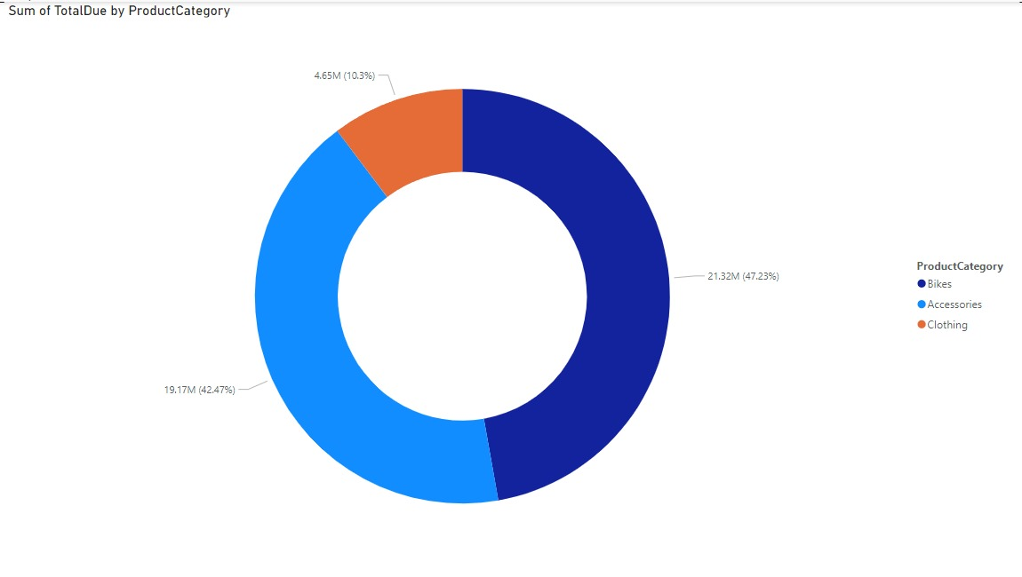
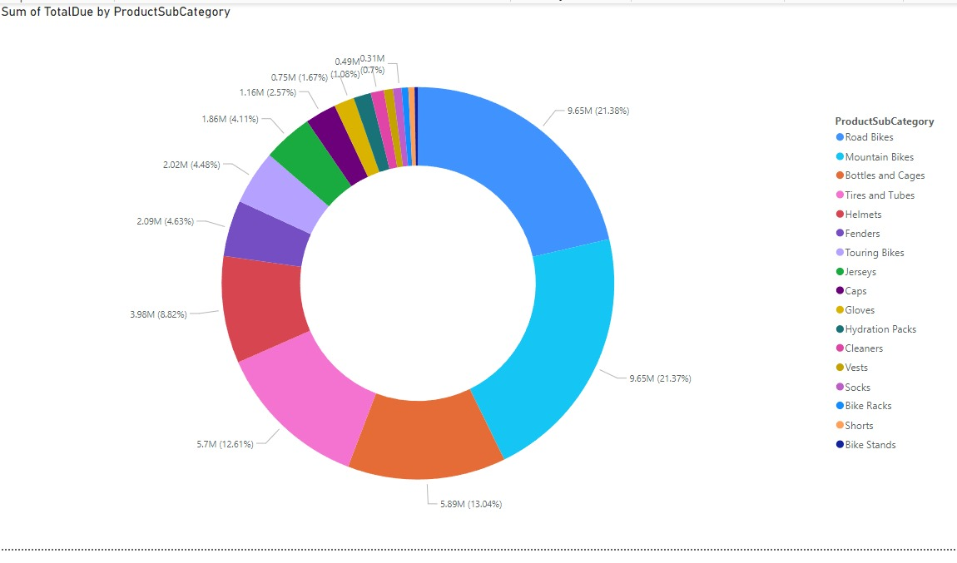
Cont. internet sales
Stores detailed internet sales data including the customer and purchase data.
Sum of total duo based on the product category
Same aspect but with attention to the sub-category

Slide 25
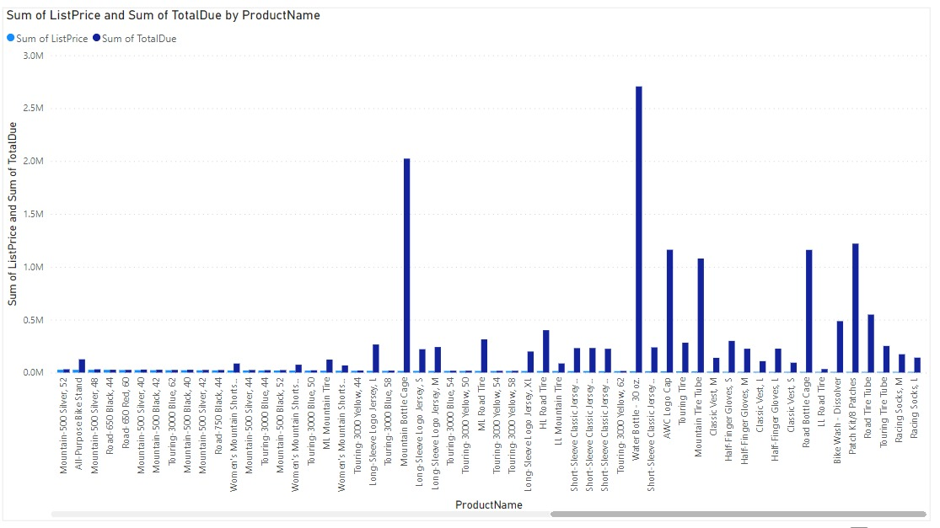
Cont. internet sales
Stores detailed internet sales data including the customer and purchase data.
In this analysis: we can conclude the lowest price and the total duo of each product. The highest-sold product was water bottles, which happened to be the cheapest item.

Slide 26
SUMMARY
This project establishes a comprehensive data model, enabling multi-faceted analysis of employee performance, sales metrics, training initiatives, manpower allocation, and internet sales. This model empowers stakeholders to make data-driven decisions in critical areas. It helps improve the performance of all the manpower by tracking the performance based on continues snapshots of the data.

Slide 27
THANK YOU

